Slide 1
2.1 Types and methods of data transmission
Describe the structure of a packet
Describe how data is transmitted from one device to another using different methods of data transmission
Understand that data is broken down into packets to be transmitted
Describe the process of packet switching
Explain the suitability of each method of data transmission, for a given scenario
Understand the universal serial bus (USB) interface and explain how it is used to transmit data
Packet header, payload , trailer , destination address , packet number , originator’s address
Data is broken down into packets
Each packet could take a different route
A router controls the route a packet takes
Packets may arrive out of order
Once the last packet has arrived, packets are reordered
Serial , parallel, simplex, half-duplex – full-duplex
Including the advantages and disadvantages of each method
Including the benefits and drawbacks of the interface

Slide 2
Today
2. Describe how data is transmitted from one device to another using different methods of data transmission
5. Explain the suitability of each method of data transmission, for a given scenario
13. Serial , parallel, simplex, half-duplex – full-duplex
Including the advantages and disadvantages of each method
Including the benefits and drawbacks of the interface
Understand: What is a packet
Able: Explain simplex, half duplex and duplex
Answer: What are the different ways a packet routes itself?

Slide 3
Data transmission
When you have something (data) and you give to someone else
You are sender
They are the receiver
Or
When someone else has data and gives to you
They are the sender
You are receiver

Slide 4
Serial data transmission
Sender
Receiver
One wire between sender and receiver
Each bit is sent in order, one after another

Slide 5
Advantages and Disadvantages
Sender
Receiver
+ Very simple
+ Cheap
+ Few errors when sending
+ Easy for receiver to receive
+ Good for long distances
Slow

Slide 6
Uses
Keyboards
Mouse's
Cables that carry video (because it has less errors)
Long distance transmission (because its cheap)
Ethernet
Fibre optic
Sender
Receiver

Slide 7
Parallel
Sender
Receiver
One cable
Inside this cable is 8 wires
Sends 8 bits nearly at the same time

Slide 8
Advantages and Disadvantages
Sender
Receiver
+ Faster than serial
+ Better for short distances
Can get more errors than serial
Crosstalk (because the wires are so close together it can be hard for the receiver to understand)

Slide 9
Uses
Sender
Receiver
Old technology
Radio transmissions
RAM
Integrated circuits

Slide 10
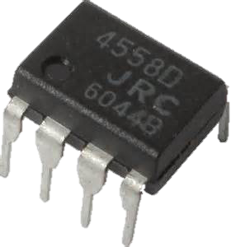
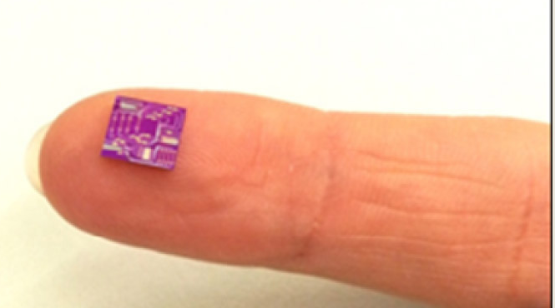
Integrated Circuits
Integrated circuit (IC) = microelectronic chip or chip
Electronic components made into one tiny unit.
Uses parallel transmission because the distance is so small

Slide 11
USB
USB = Universal Serial Bus
Its Serial but different….
In serial one bit is sent at time.
If a group of bits is being sent and you want to send something – you must wait for the first group to finish
With USB this waiting doesn’t happen.
USB is asynchronous

Slide 12
Synchronous and Asynchronous
Synchronous uses time
Asynchronous uses special bits
What the hell are you talking about Mr Amar?!
Okay imagine if two people want to talk to teach other.
The first person wants to say:
“I think Thanos was correct, even though he killed half the population, the world is overcrowded and by killing people, it means the world has balance and the Earth will be good”
Lets see how this message can be sent using synchronous or asynchronous methods

Slide 13
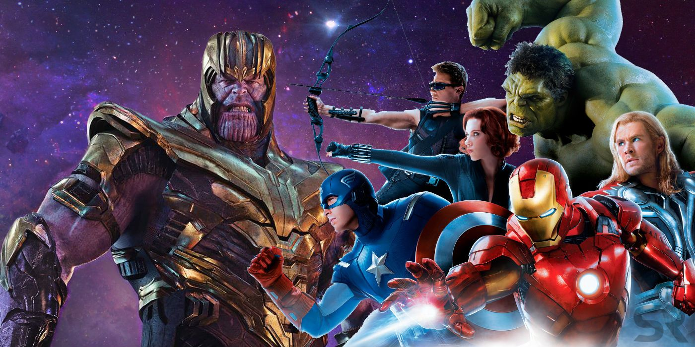
Thanos
“I think Thanos was correct, even though he killed half the population, the world is overcrowded and by killing people, it means the world has balance and the Earth will be good”
Now if you just say this sentence, it could take 1 second, maybe 2 seconds, maybe 3 seconds…. It doesn’t matter, you just say all the information you want to say in as much time as it takes.
But this is not how data is sent.
To help me teach it, we will break the
data in parts.

Slide 14
Parts
I think Thanos was correct, even though he killed half the population, the world is overcrowded and by killing people, it means the world has balance and the Earth will be good
So we have a black part, a blue part and a yellow part.
Now you have 1 second to say each part
Can you say the black part in 1 second? Maybe yes.
The blue part in 1 second? Maybe yes.
They yellow part in 1 second? Maybe if you Eminem
But that is how synchronous data transmission works

Slide 15
Synchronous data transmission
The sender and the receiver both have to agree on a time frame. In our example we said 1 second.
The sender then sends ALL the data in one continuous stream.
I think Thanos was correct, even though he killed half the population, the world is overcrowded and by killing people, it means the world has balance and the Earth will be good
The receiver waits for the agreed time frame (1 second) and then you have to hope that all your data was sent within that time frame.
Your timings must be super perfect for everything to match up, otherwise the receiver will think its getting the start of a new piece of data whereas its really getting the end of the first piece of data because you could not get your timings to match.

Slide 16
Asynchronous data transmission
This does not care about timing.
This just splits your data into parts
I think Thanos was correct, even though he killed half the population, the world is overcrowded and by killing people, it means the world has balance and the Earth will be good
At the start and end of each is a start bit and stop bit.
So when the receiver gets the data, they can tell where the start is and where the end is of that part, it doesn’t matter if you both have the same timing or not.

Slide 17
Synchronous vs Asynchronous
Synchronous :
Uses time. Usually millions of things per second. Same speed as your CPU clock
+ Faster. Because you send everything in one continuous stream
- Your timing must be accurate otherwise mistakes will happen
Asynchronous :
Uses Start bits and Stop Bits.
+ More reliable than synchronous because you don’t need timing
- You need to add start bits and stop bits

Slide 18
USB
It depends on the device you connect but USB can have 3 modes
Interrupt - A device like a mouse or a keyboard, which will be sending very little data, would choose the interrupt mode.
Bulk - A device like a printer, which receives data in one big packet, uses the bulk transfer mode. A block of data is sent to the printer (in 64-byte chunks) and verified to make sure it's correct.
Isochronous - A streaming device (such as speakers) uses the isochronous mode. Data streams between the device and the host in real-time, and there is no error correction.

Slide 19
Which is better?
Serial or Parallel? What’s best??
Honestly, now its serial.
Yes it can only transmit 1 bit at a time but cables are so fast now it doesn’t matter.
And there are less errors because its easier to receive the data
And you can make the wire longer
And the wire takes up less space (only 1 line and not 8)

Slide 20
One way?
This next bit is super simple…..but has stupid names
Simplex
Half-Duplex
Full Duplex

Slide 21
Simplex
Simplex:
Data goes only in one direction
Example: Keyboard to processor

Slide 22
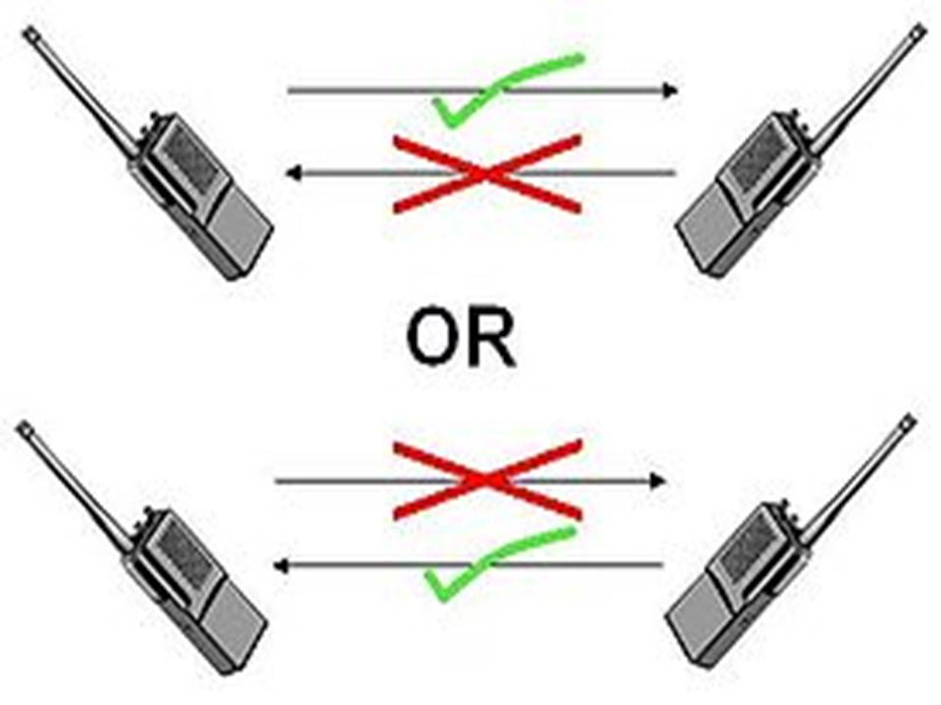
Half Duplex
Half Duplex
Data can go in both directions
But it must wait for the other data to finish
Example: Walkie-Talkie

Slide 23
Duplex
Duplex
Data can go in both directions at the same time
Example: Telephone

Slide 24
Today
Describe the structure of a packet
3. Understand that data is broken down into packets to be transmitted
4. Describe the process of packet switching
7. Packet header, payload , trailer , destination address , packet number , originator’s address
8. Data is broken down into packets
9. Each packet could take a different route
10. A router controls the route a packet takes
11. Packets may arrive out of order
12. Once the last packet has arrived, packets are reordered
Understand: What is a packet?
Able: Know what goes into a packet
Answer: What are the advantages and disadvantages of packet switching and circuit switching

Slide 25
What do we actually send?
So we know we can send things as serial or parallel.
We know we can send things as simplex, half duplex or (full) duplex.
Those things are terms used in data transmission, but it can apply to voice transmission.
But the BIGGEST form of data transmission is when we send things over a network.
Network = Two or more computers connected to each other
The BIGGEST network in the world is The Internet
So, how do we send things over the Internet?
We will go over this is more detail than you need. But its actually easier if you know more.

Slide 26
Data Communication System
Very simple.
If you want to communicate data, you need 5 things.
Pick the 5 you think
MEDIUM
CABLES / WIRES
SENDER
RECEIVER
COMPUTER
MESSAGE
HUB
BROADBAND
PROTOCOL

Slide 27
Data Communication System
Here are the 5 things
MEDIUM
SENDER
RECEIVER
MESSAGE
PROTOCOL

Slide 28
Data Communication System
SENDER
THE PERSON GIVING / WANTING TO GIVE DATA
RECEIVER
THE PERSON WHO WILL GET THE DATA
MEDIUM
HOW YOU WILL SEND IT (WI-FI, CABLE..) ALSO CALLED TRANSMISSION MEDIUM
MESSAGE
WHAT THE DATA ACTUALLY IS
PROTOCOL
THE RULES ON HOW YOU WILL SEND

Slide 29
Packets
Ahhh…… here is why I ‘like’ Computer Science….. So many stupid words for simple things.
Today’s stupid word is Packet
Does these sentences make sense?
A network allows you to send data
Data can be sent from one node to another
Makes sense I hope.
We know what data is. But when we talk about networks, we don’t say data, we say packets or data packets or datagram.

Slide 30
Packets, Data Packets, Datagram
Packets, data packets and datagrams, three words that mean the same thing.
We will call it packet.

Slide 31


Original Message
Okay we have three people. Iron Man, Black Widow and Hulk.
And we have a message also – I LOVE YOU
Hulk wants to send this message to Black Widow
I LOVE YOU

Slide 32
Original Message
Look at his message. Is it okay to send?
What was the 5 things needed to send a message?
Sender
Receiver
Medium
Message
Protocol
We have a message but that’s all.
I LOVE YOU

Slide 33
Extra information
So we need to add Sender and Receiver
So now I have
Sender information
My original message
Receiver Information
And now we come to a problem…..
Its too big to send.
Sender:
Hulk
I LOVE YOU
Receiver:
Black Widow

Slide 34

Packets
Packets
Anytime you send something over the internet, you will use something called TCP/IP – we will cover this later.
But our problem is our information is now too big so we need to break it down into smaller parts.
These smaller parts is called a packet.
So here we have split it into 4 parts. Does this mean we have 4 packets?
No!

Slide 35
Packet Size and Problem
So now we have 4 parts, we can send it right?
Wrong!
We just have 4 parts of something.
We need to add even more information on to it to make it a packet.

Slide 36
Packet Structure
Sender: Hulk
Receiver: Black Widow
Protocol: TCP/IP
Packet 1 of 4
Checksum: 877
End of Packet
Sender: Hulk
Receiver: Black Widow
Protocol: TCP/IP
Packet 2 of 4
Checksum: 223
End of Packet
Each Packet must have:
Sender
Receiver
Protocol Used
Packet Number
Payload
Error Correction
End of Packet
Now we have 4 packets
Sender: Hulk
Receiver: Black Widow
Protocol: TCP/IP
Packet 3 of 4
Checksum: 658
End of Packet
Sender: Hulk
Receiver: Black Widow
Protocol: TCP/IP
Packet 4 of 4
Checksum: 454
End of Packet

Slide 37
Packet
Data is broken up into little parts.
These parts are given some extra information to make it a packet.
A packet is around 1000-1500 bytes
Each packet it send along the network and may have different routes
The route it goes on depends on the speed and efficiency
The packet contains some extra information, not just the data you want to send

Slide 38
Packet (size 1024 byte)
HEADER | SENDER IP ADDRESS RECEIVER IP ADDRESS PROTOCOL USED PACKET NUMBER (3 of 7) | 96 byte
PAYLOAD | YOUR ACTUAL DATA | 896 byte
TRAILER | SHOWS END OF PACKET ERROR CORRECTION | 32 byte

Slide 39
Real Structure
Its actually more complicated then that, but we don’t need to know it just yet

Slide 40
ARE WE DONE YET?!
So we have done….
What is a network
Why we use networks
Data Communication System and the 5 parts
Client and Server
Peer to Peer
Point to Point
LAN
WAN
Topologies (Bus, Ring, Star, Mesh)
Packets
Is that it?
Yes. Yes. Yes…….
…. I mean NO, NO, NO, NO – that’s not it. Cambridge wants us to know HOW the packets move around.

Slide 41
Packet Movement
A packet moves around a network in two ways.
Circuit Switching
Packet Switching

Slide 42
Video Questions
Which method is more susceptible to hacking?
Which transmission mode allows for data to be split up?
Which method uses the same route for all packets?
Which method takes longer to assemble at the receiver end? Why?
Why is circuit switching more reliable than packet switching?

Slide 43
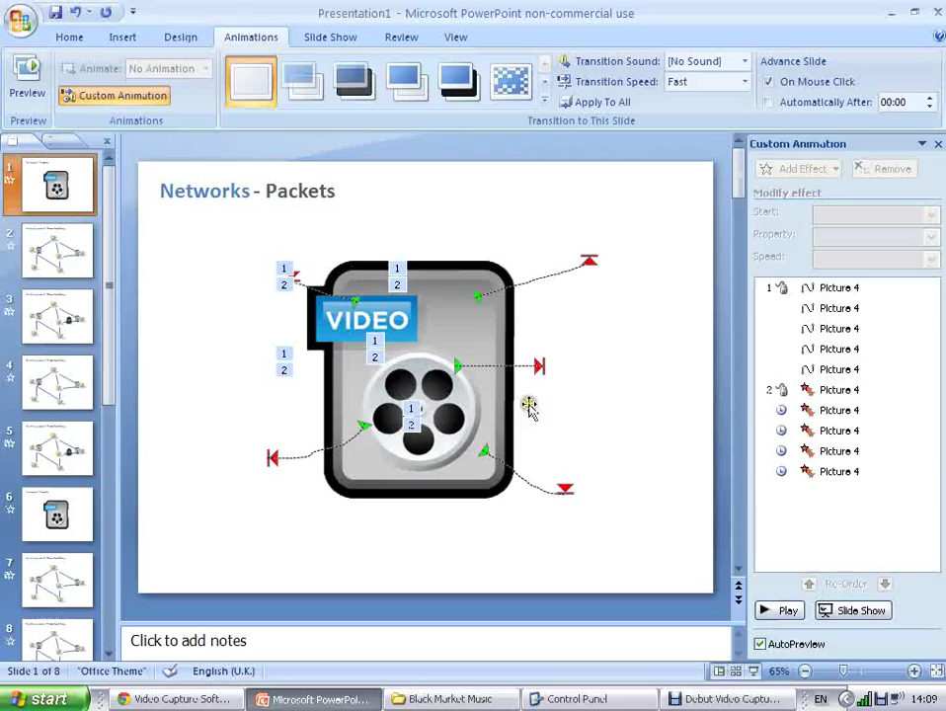

Slide 44
Some notes on circuit switching
There are steps to this:
Sender says who they want to send to (who is the receiver)
System checks to make sure the receiver is ready to accept
If receiver is available then the links are established (the circuit)
Data is sent
The links are removed
Because the links made are dedicated, data can be sent without impediment.
Its reliable because you are only sending if you know the receiver can receive and you know the medium is stable enough to handle it.
At the end of transmission the circuit lines can either be removed or if the line was a leased line the connection is permanent.
Like if you had a dedicated phone line that always goes to one number.

Slide 45

How a telephone called was made in 1950s.

Slide 46
Packet Switching
When data is split into packets but sent over different routes
The receiver then has to arrange the packets in the correct order, which may be different then the order the packet arrived.
That’s why we need packet numbers

Slide 47
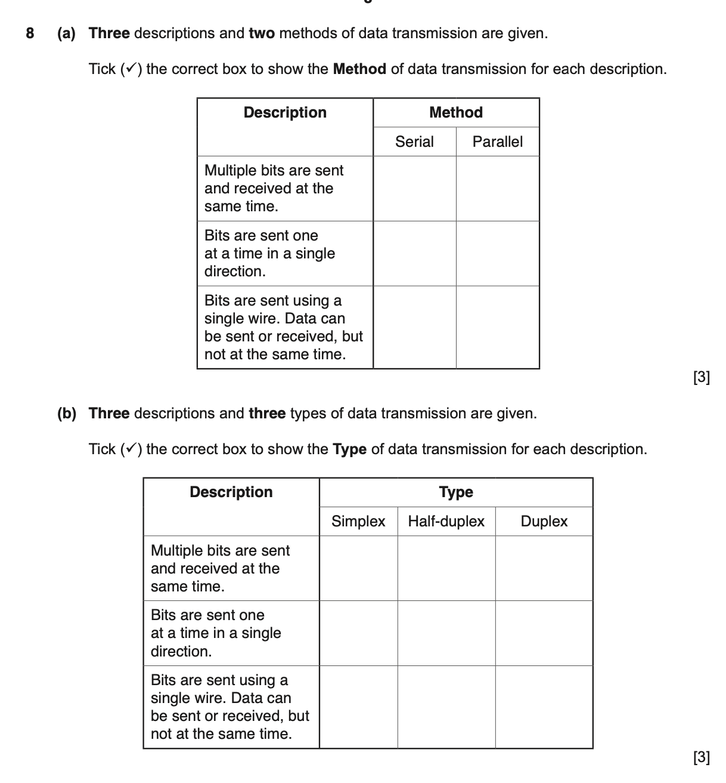
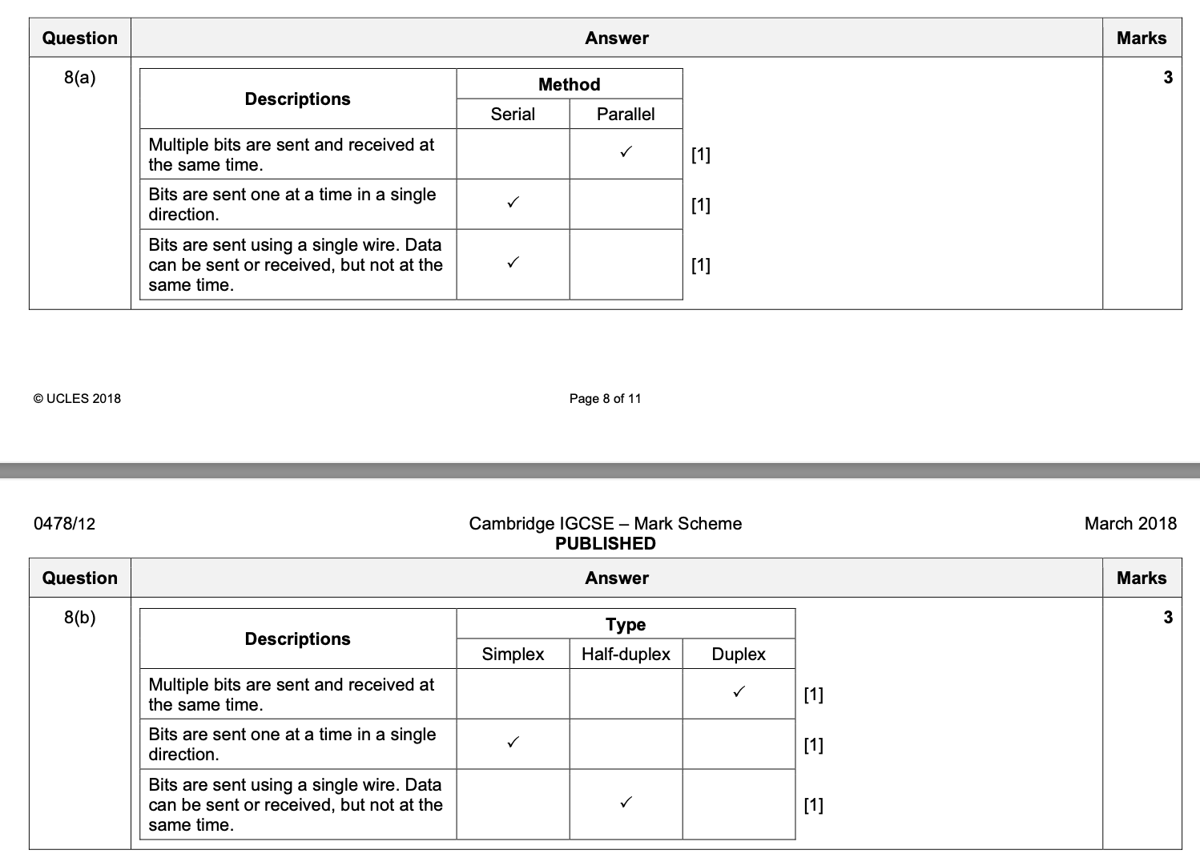

Slide 48
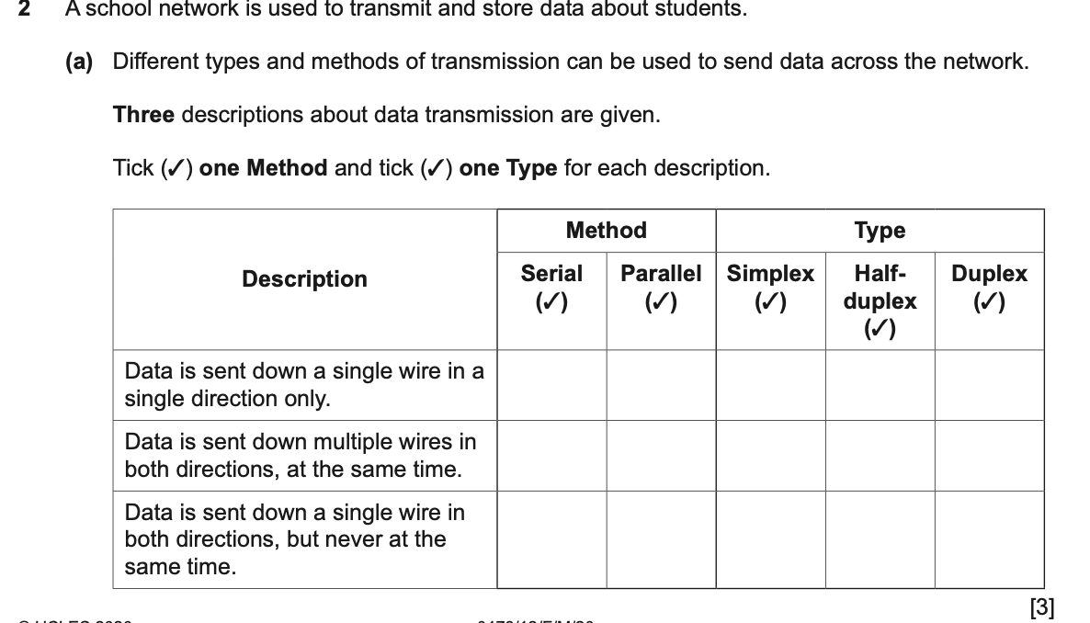
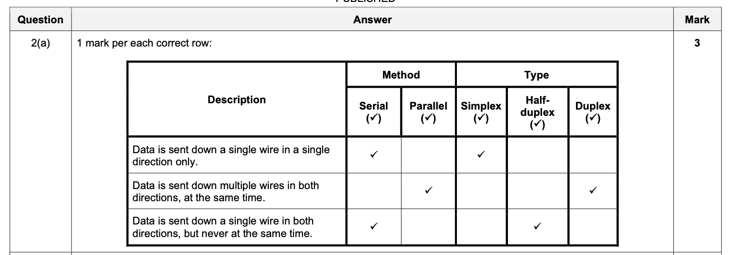

Slide 49
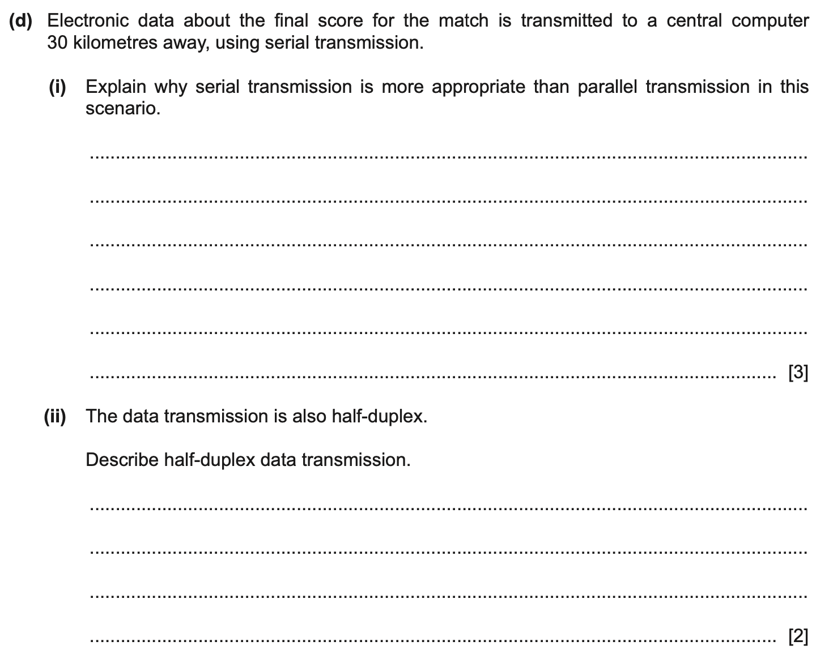
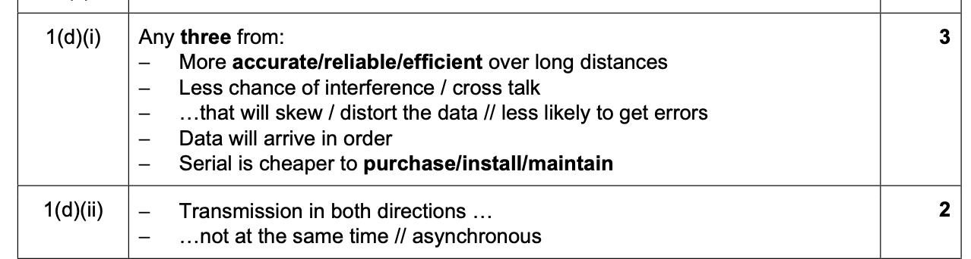

Slide 50
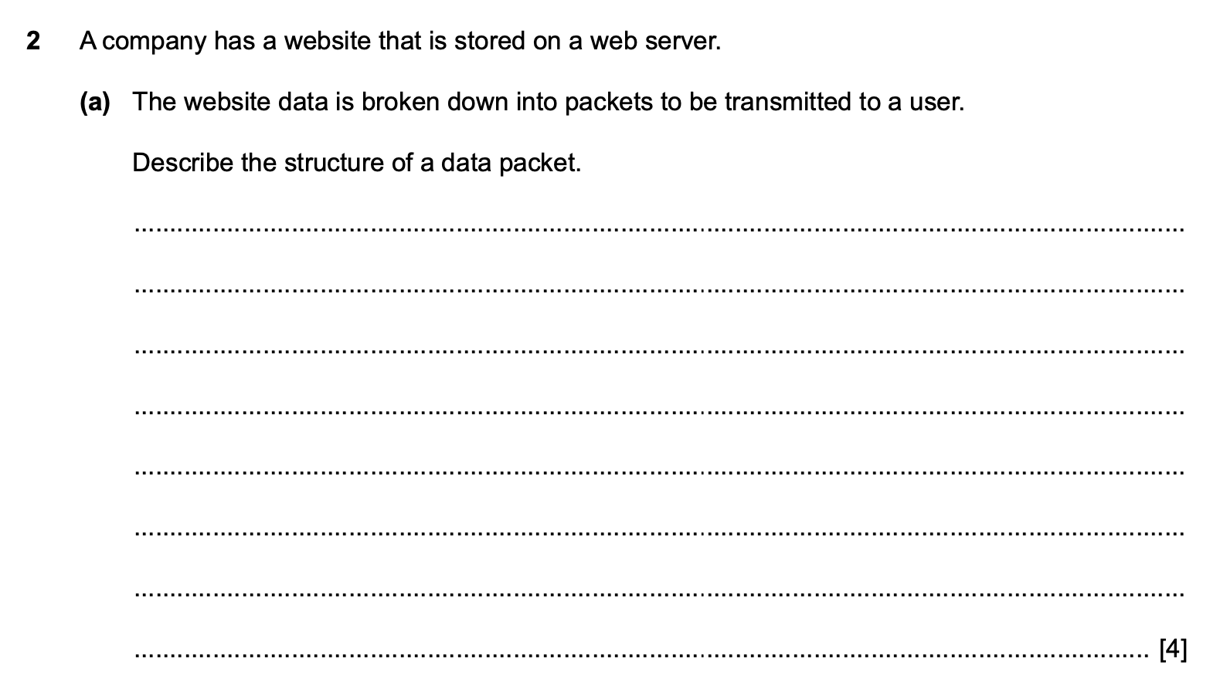
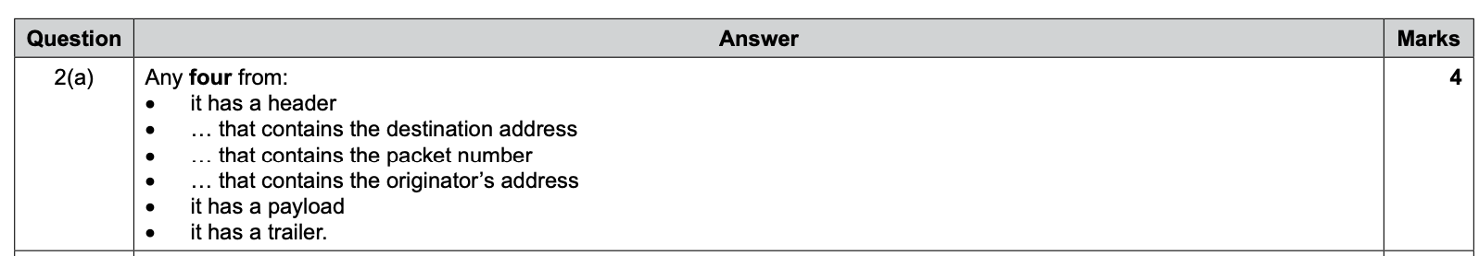

Slide 51
